Slide 1





Red & Yellow Soils
By: Greeshmanth, Kaushal, Satvik, Akshat
10E

Slide 2
Introduction
Today's presentation is about Red and Yellow soils. These two soils hold immense significance in agriculture, ecology, and geology of India. They are found in various regions like coastal plains. Also known as the “omnibus group”. It covers about 18.5 % of the total land area of the country.

Slide 3
Formation
It is formed on crystalline, igneous and metamorphic rocks.
It is present in areas rich in minerals like the Deccan plateau.
They are formed from the lesser fertile lateritic soils.
It is formed due to weathering and erosion of rocks like granite, basalt etc. along with heating which is faced in tropical and subtropical regions of the world.

Slide 4
Characteristics of Red and Yellow Soils
Soil appears to be red due to the presence of ferric oxide
It will appear to be yellow in its hydrated form
The finer soils are more fertile than the course-grainy soils.
It is deficient in lime, phosphate, manganese, nitrogen, humus and potash.
The crops grown on these soils include wheat, cotton, tobacco, millets and pulses.

Slide 5
Location
In India:
It is found in regions of low rainfall such as the eastern and southern parts of the Deccan Plateau, Central Highlands, Chhota Nagpur plateau and piedmont of Western ghats.
It is also formed in parts of Odisha, Chhattisgarh and southern part of Ganga plains.
In World:
It is found in regions of south China, most part of Brazil, Zaire basin of Africa and the coastal areas of Australia.

Slide 6
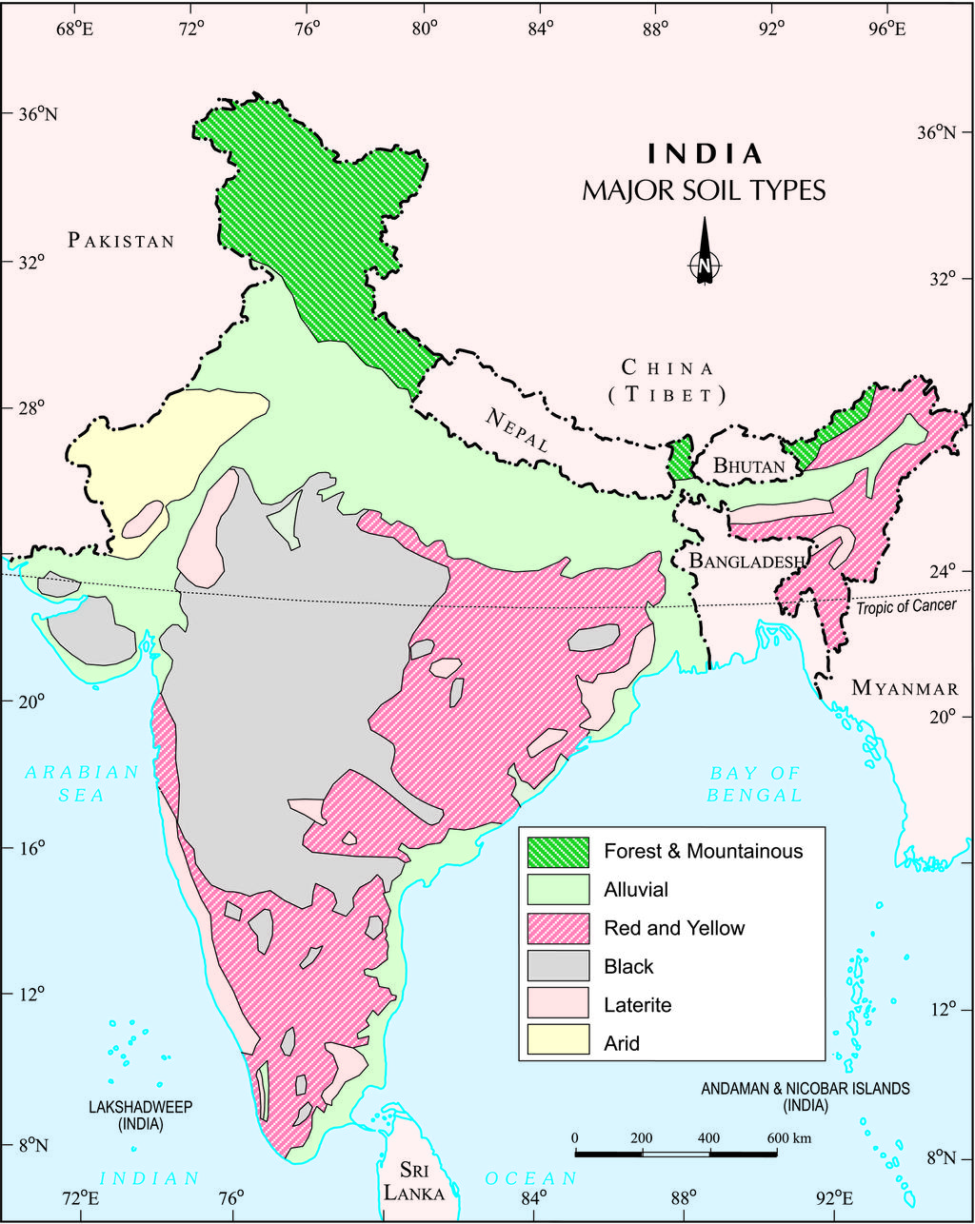
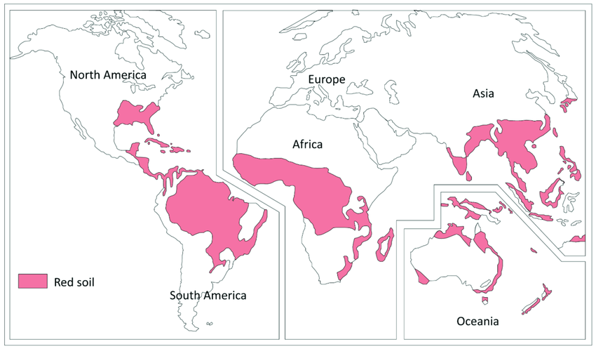
Red and Yellow Soils on the Map

Slide 7
Conclusion
Red Soils develop on crystalline igneous rocks in areas of low rainfall in the eastern and southern parts of Deccan Plateau.
It is mostly found in the parts of Odisha, Chhattisgarh.
Colors:
Reddish: due to diffusion of iron in crystalline metamorphic rocks
Yellow: when it occurs in hydrated form

